Slide 1
SCI 6338 A1
Quinn He
Xiaofei Hong
Jessica Chen

Slide 2
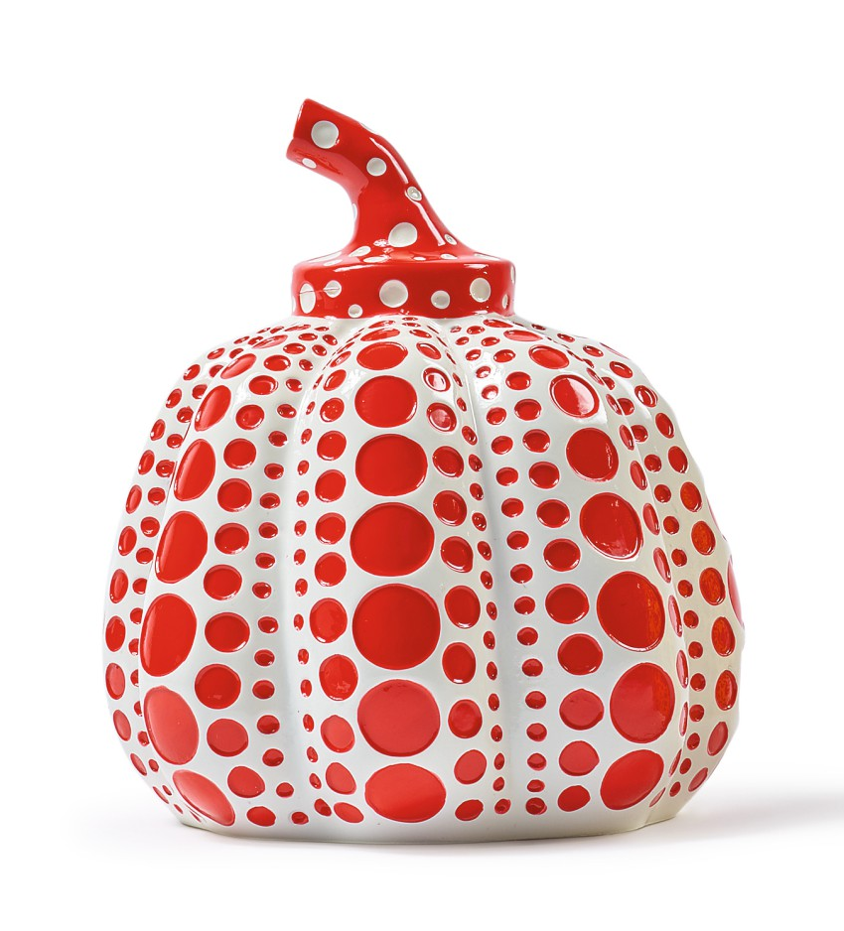
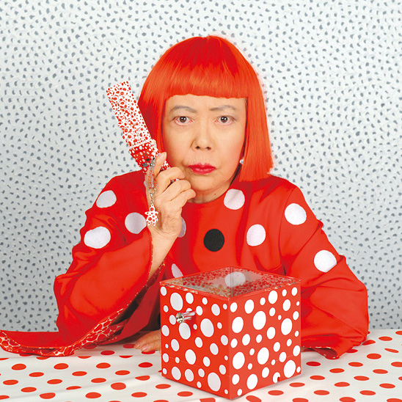
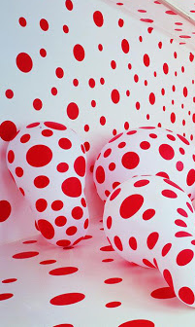
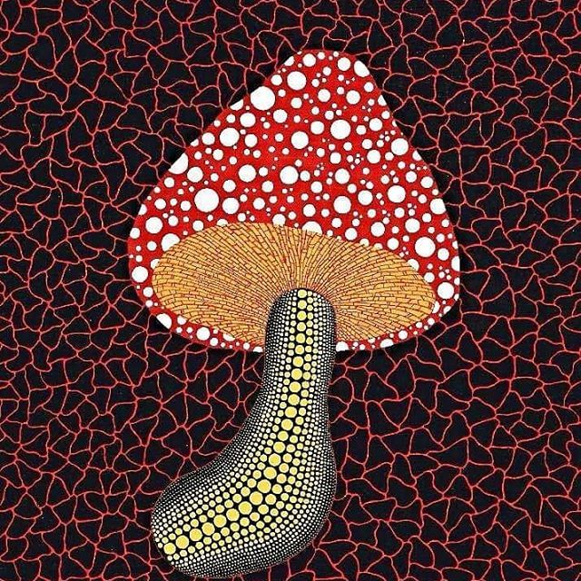
Inspiration：work from Yayoi Kusama

Slide 3
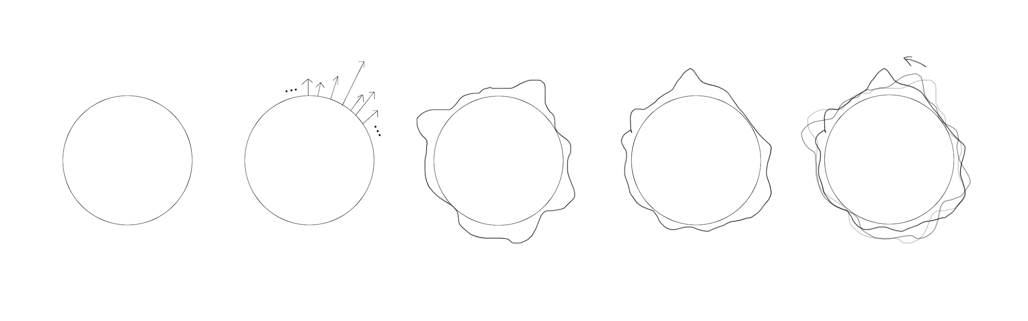
World: Surface
01
Mesh Sphere
02
Perlin Noise
03
Translate the faces along the noise vector
04
Control the base geometry with a timer
05
Set the vector as accelerate instead of location to lerp

Slide 4
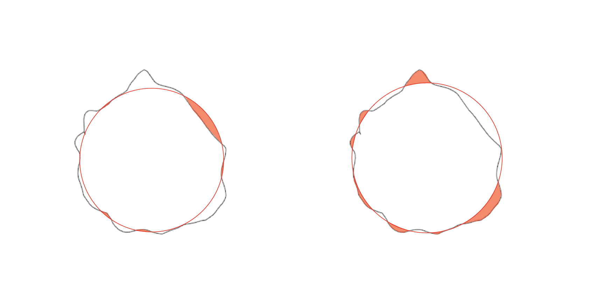
World: Identify Planting Points
06
Identify possible locations for planting pumpkins
07
Identify possible locations for planting mushrooms

Slide 5
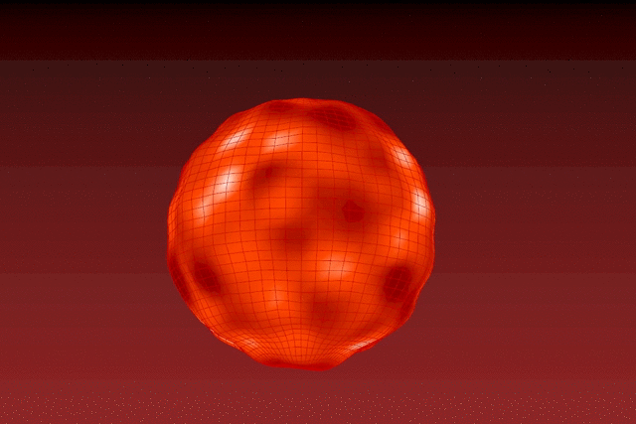

Slide 6
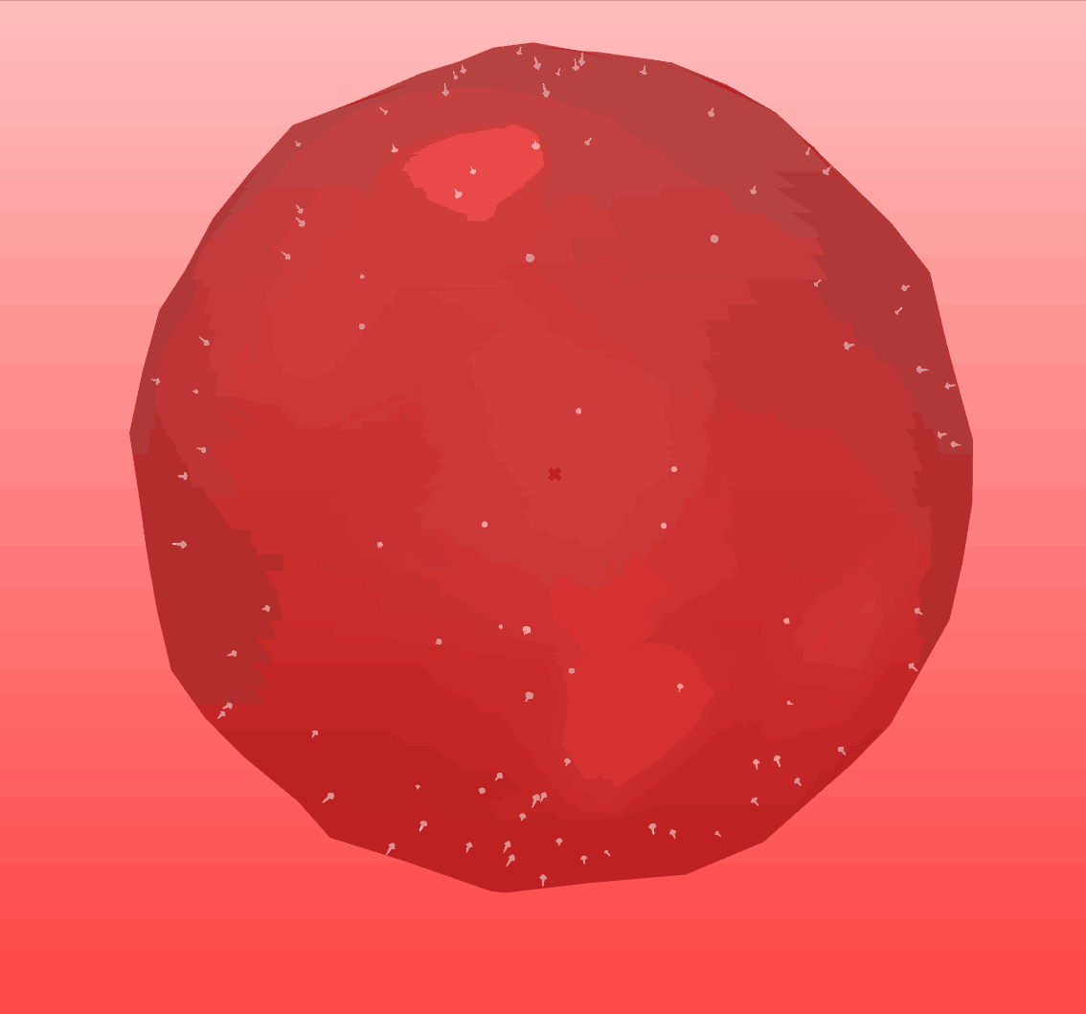

Slide 7
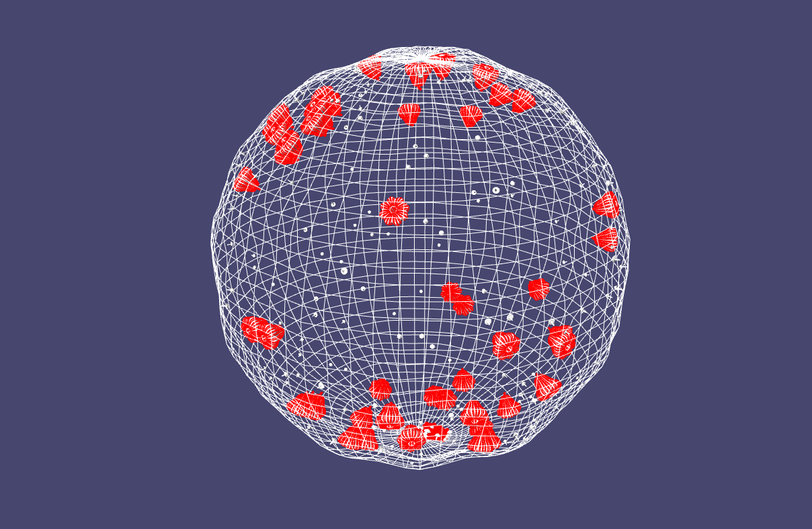

Slide 8
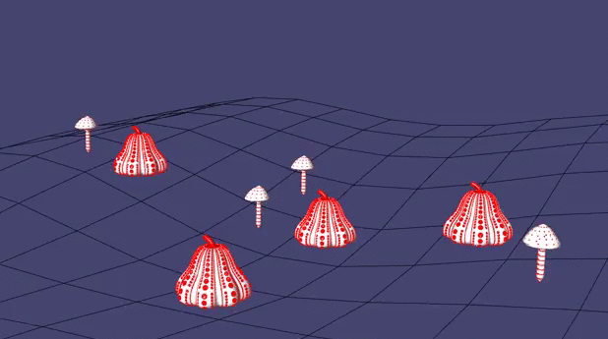

Slide 9
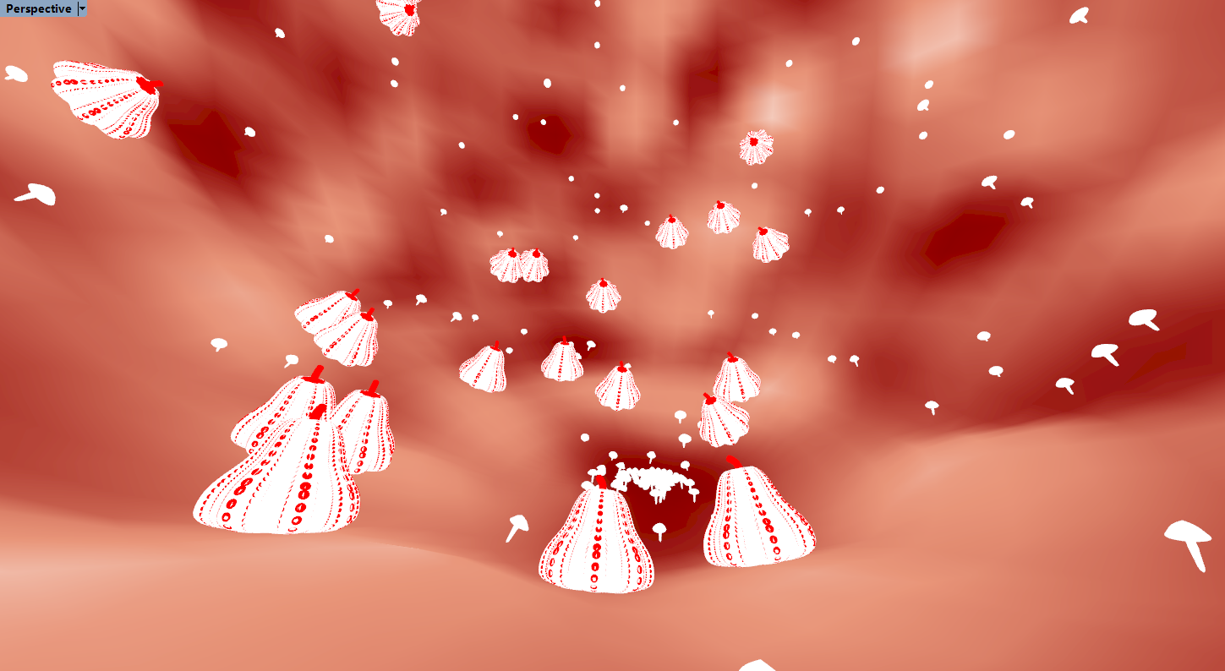
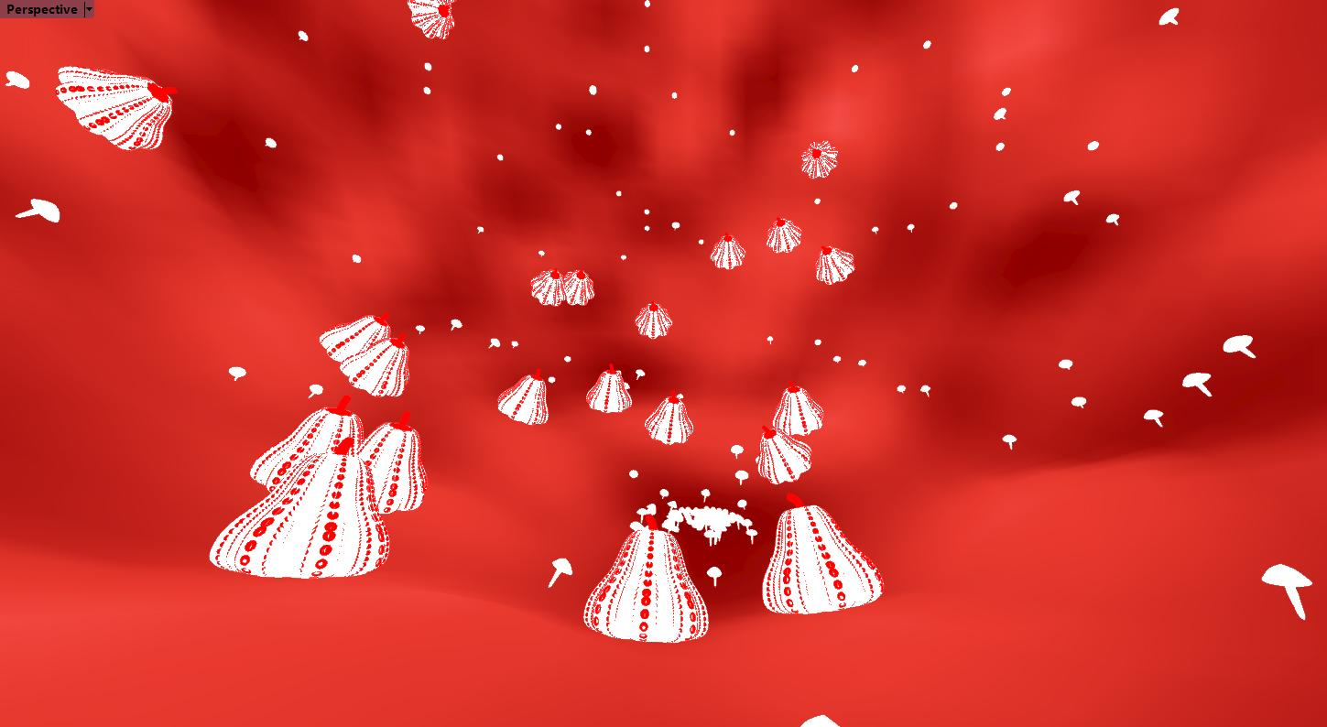
World

Slide 10
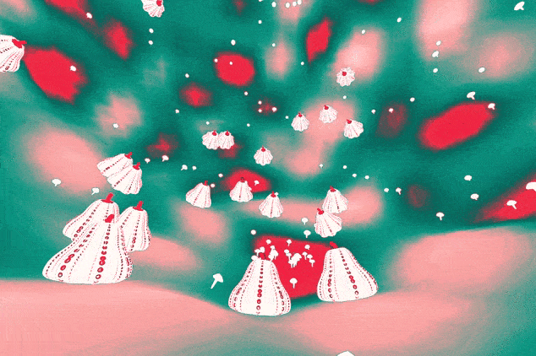

Slide 11
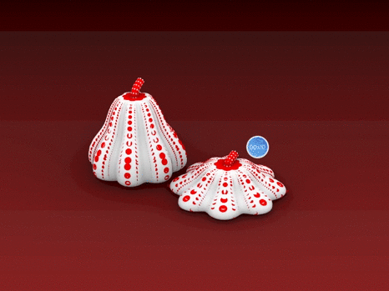
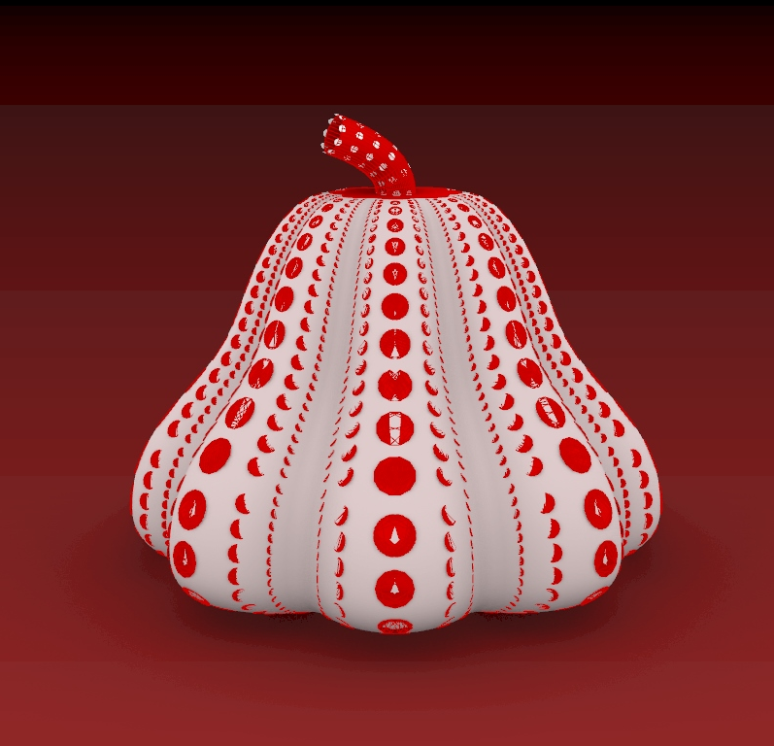
Pumpkin

Slide 12
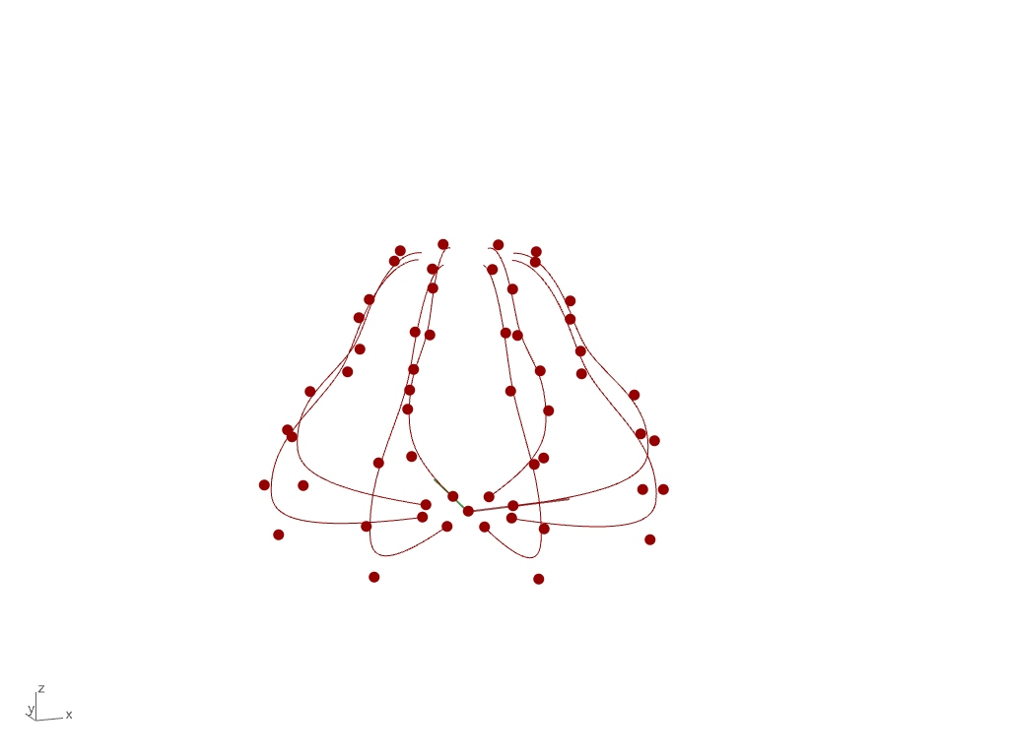
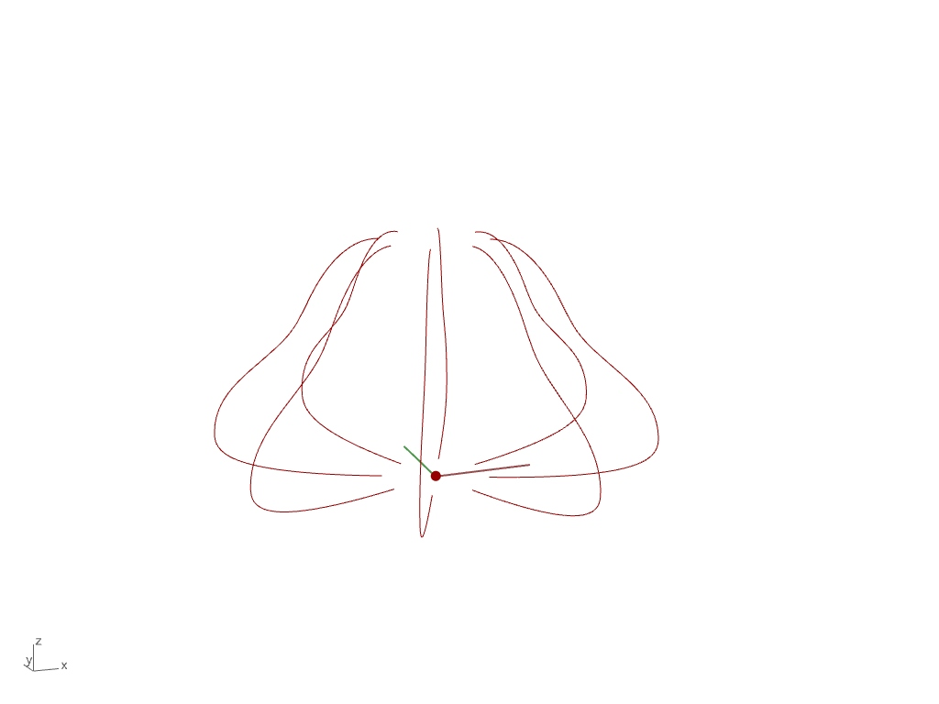
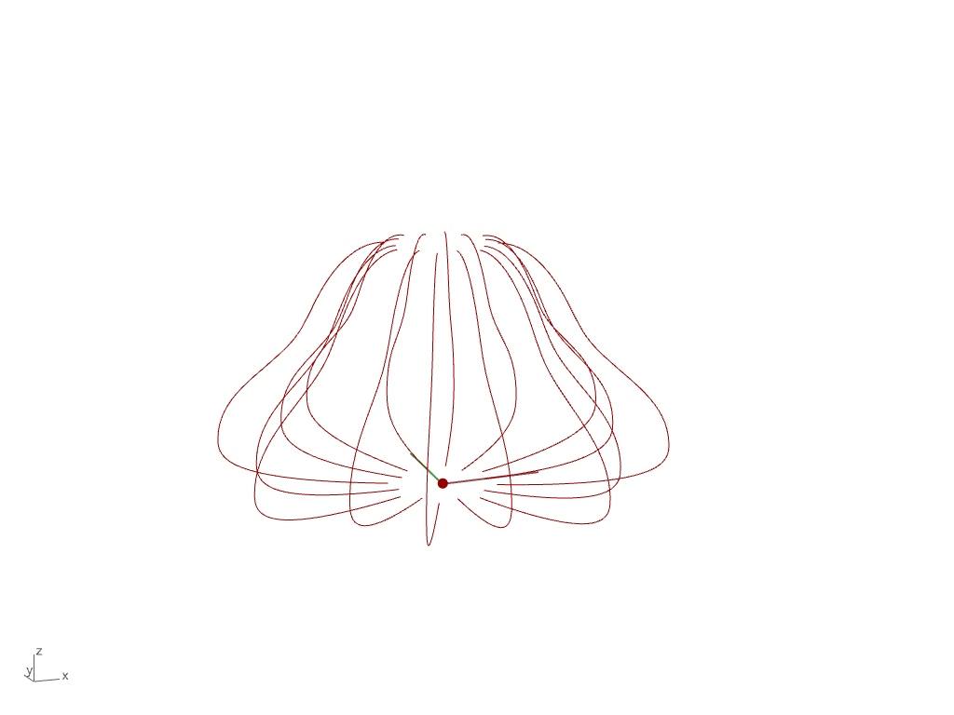
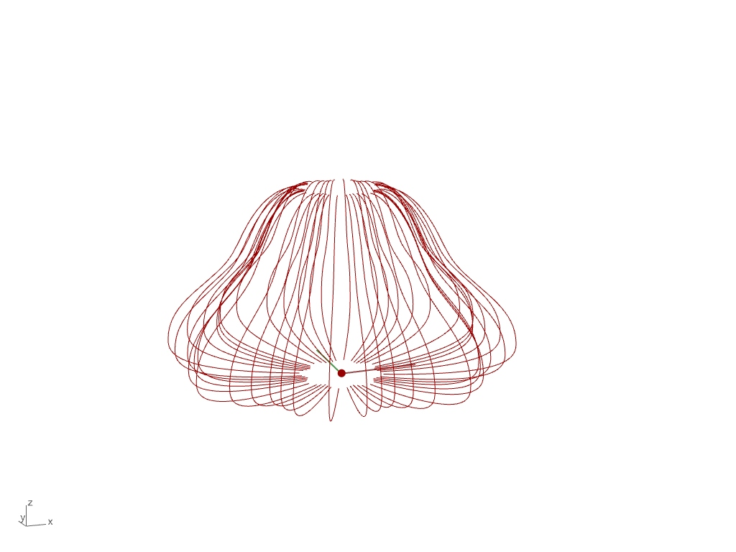
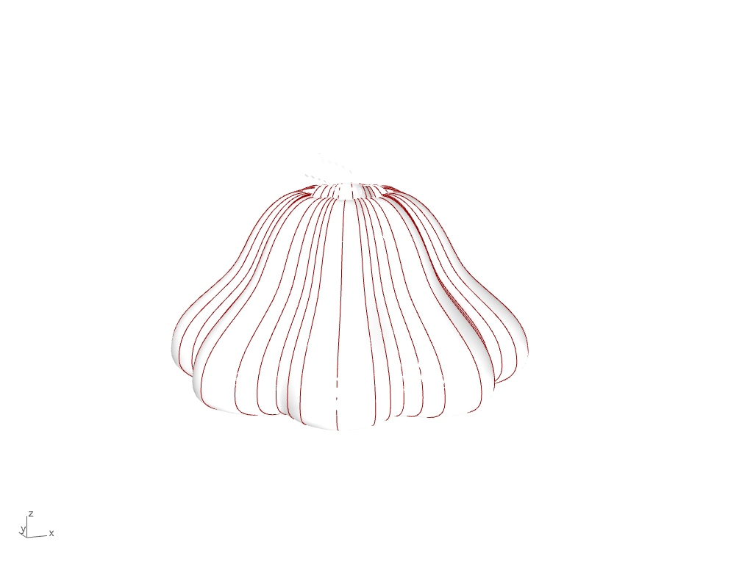
Pumpkin: Surface
01
Control Point list
02
Scale inner and rotate to get outer edge
03
Edge to loft around center
04
Interpolate control curve in middle
05
Brep[]Loft

Slide 13
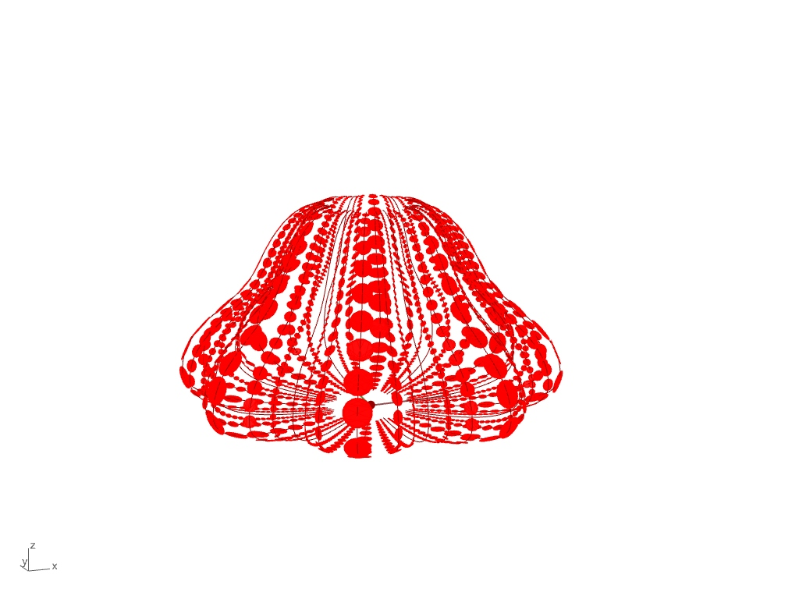
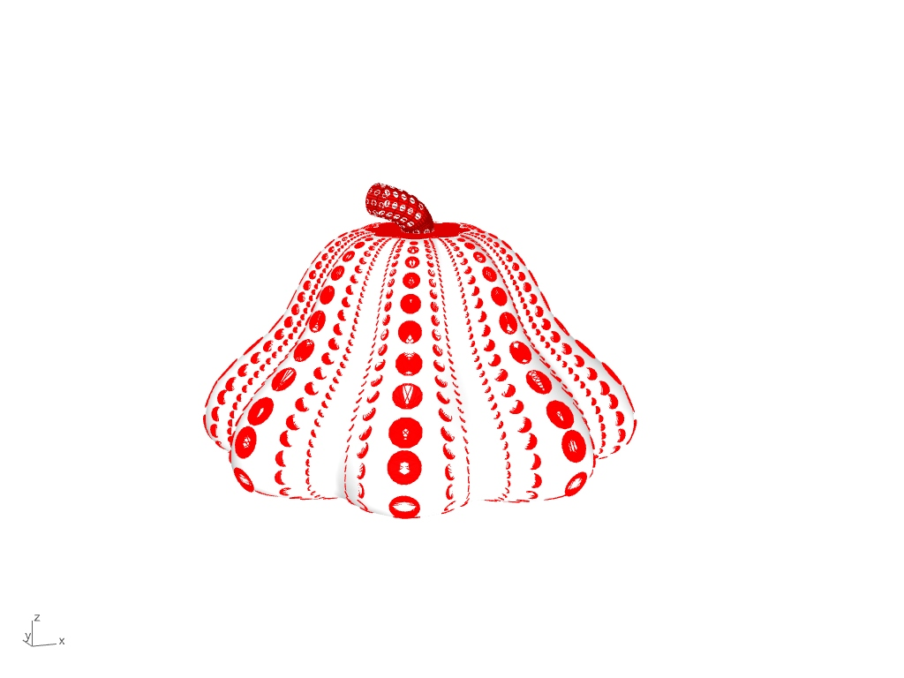
Pumpkin: Surface
06
Generating Points bigger in middle and smaller on the edge
07
Add the Cap

Slide 14

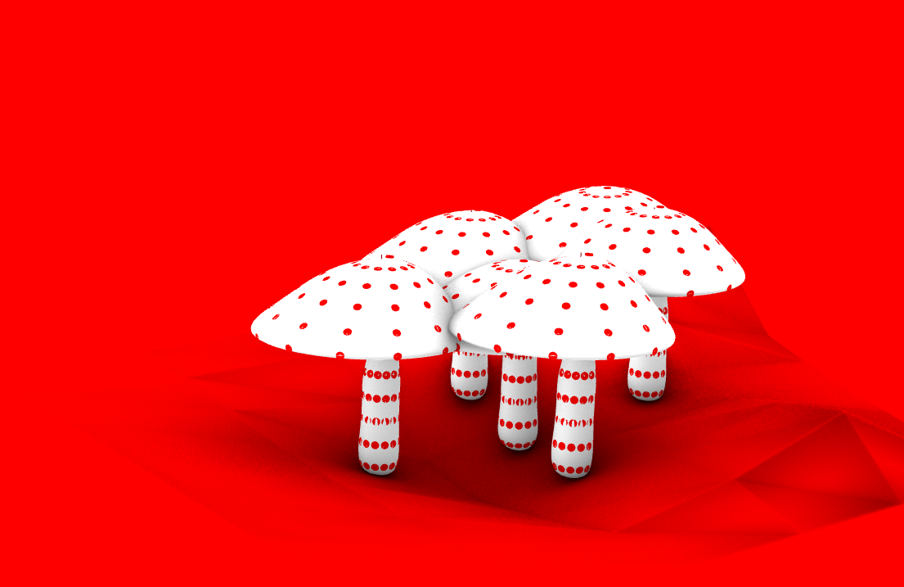
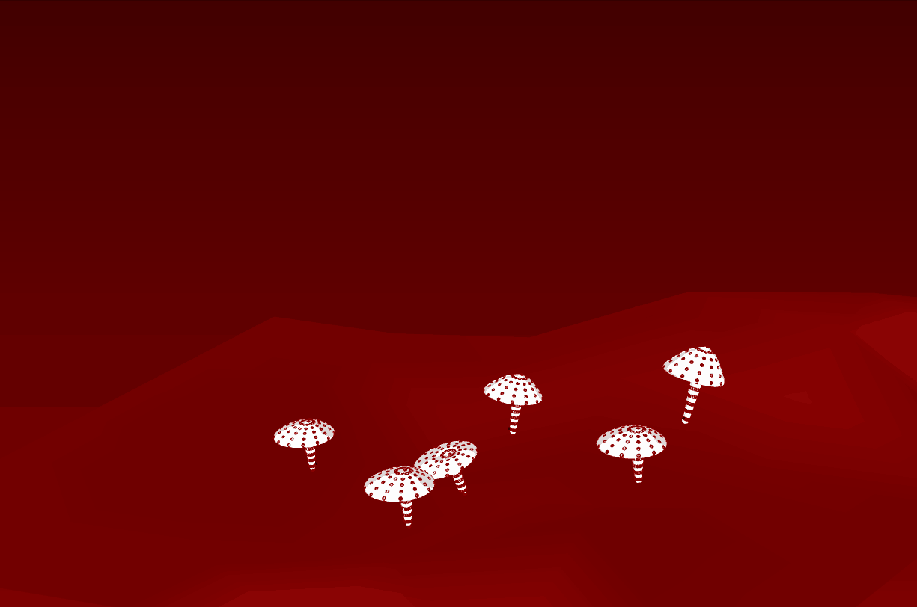
Mushroom

Slide 15
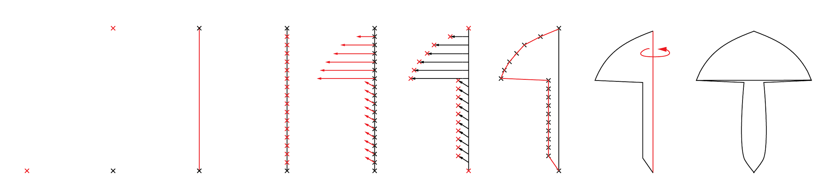
Mushroom: Surface
01
Staringt Pt
02
Offset Pt
From starting Pt
03
Make a line from the two Pts
04
Identify Pts on the line by dividing the line into equal segments
05
Create direction vectors to move the points ( allocate first ⅓ of the Pts for the mushroom head, last ⅔ for the mushroom body)
06
Move the points along the vectors
07
Create a curve through the points
08
Revolve the curve around the line to create a surface
09
Mushroom Surface

Slide 16
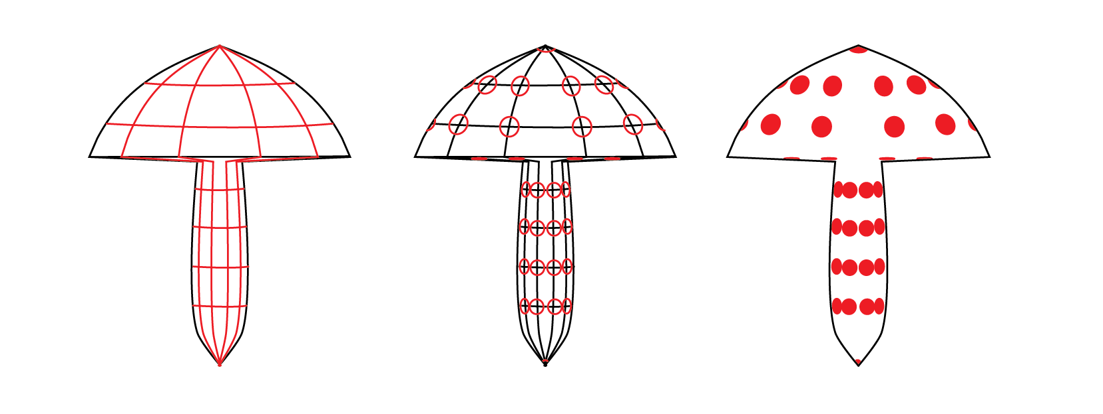
Mushroom: Dots
10
Divide the surface in U and V directions
11
Generate circles on the surface from the intersecting points
12
Create circle surfaces

Slide 17

Inhabitants

Slide 18
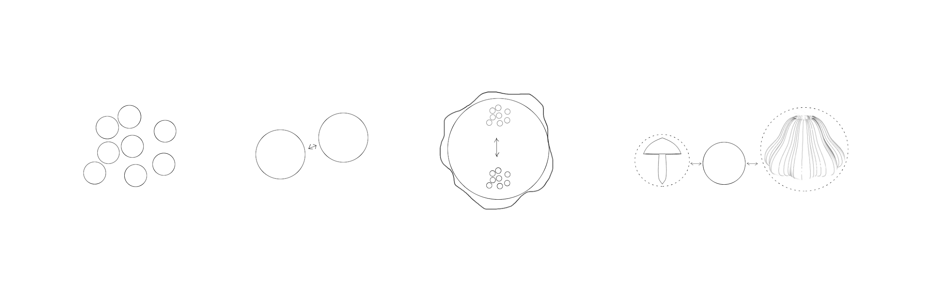
Inhabitants
01
Populate geometry with points
02
Collisions between spheres
03
Load forces to control movements within the world
04
Keep spheres outside the bounding sphere of pumpkins & mushrooms

Slide 19
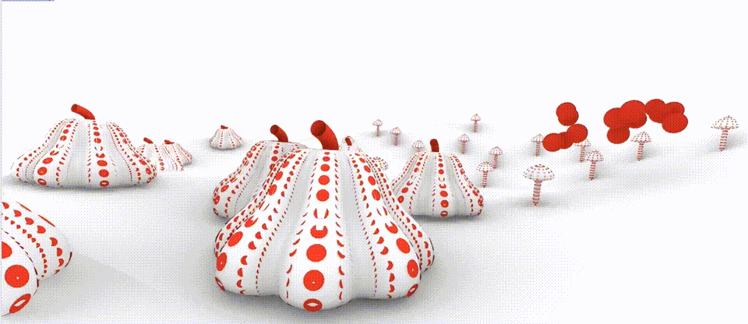

Slide 20

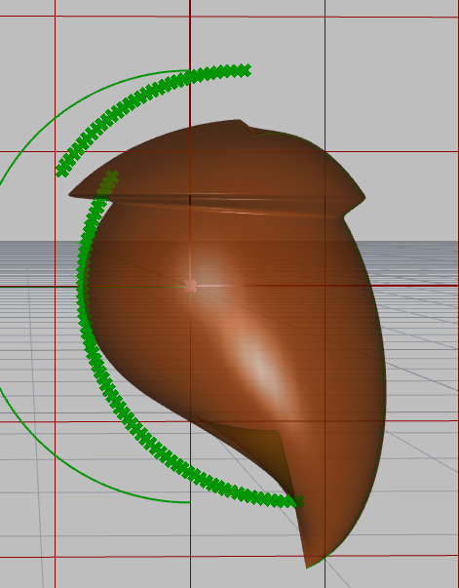
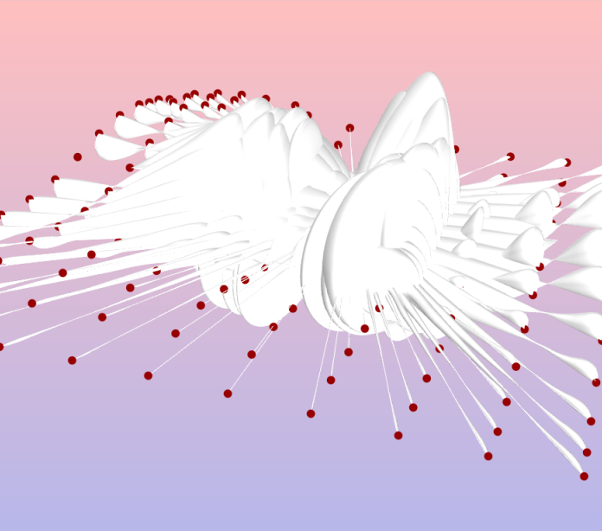
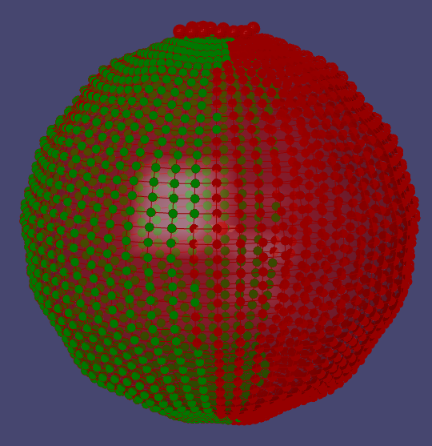
Progress and Errors
We were first interested in the Klein bottle as our base surface, but it was too complex to work with
Starting with an arc as the base was a bad idea, hard to control where the points offset to, mushroom looked strange (later used a line instead)
Messed up with data tree
Test with point set split

